Slide 1

2022 ANNUAL REPORT
February 2023

Slide 2

ANNUAL REPORT TO THE COMMUNITY
OUTLINE
  FAL BOARD
  MISSION/GOALS
  PROGRAMS
  FINANCIAL UPDATE
  QUESTIONS

Slide 3
FAL MISSION
Provide opportunities to contribute to the ongoing services and growth of the Alameda Free Library for the enjoyment and benefit of the entire community.
Steward the Library and its many services and programs through advocacy, volunteerism, and fund raising to supplement public funding.

Slide 4
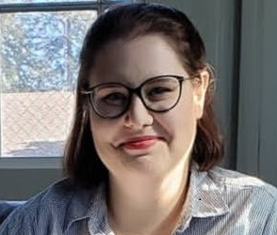
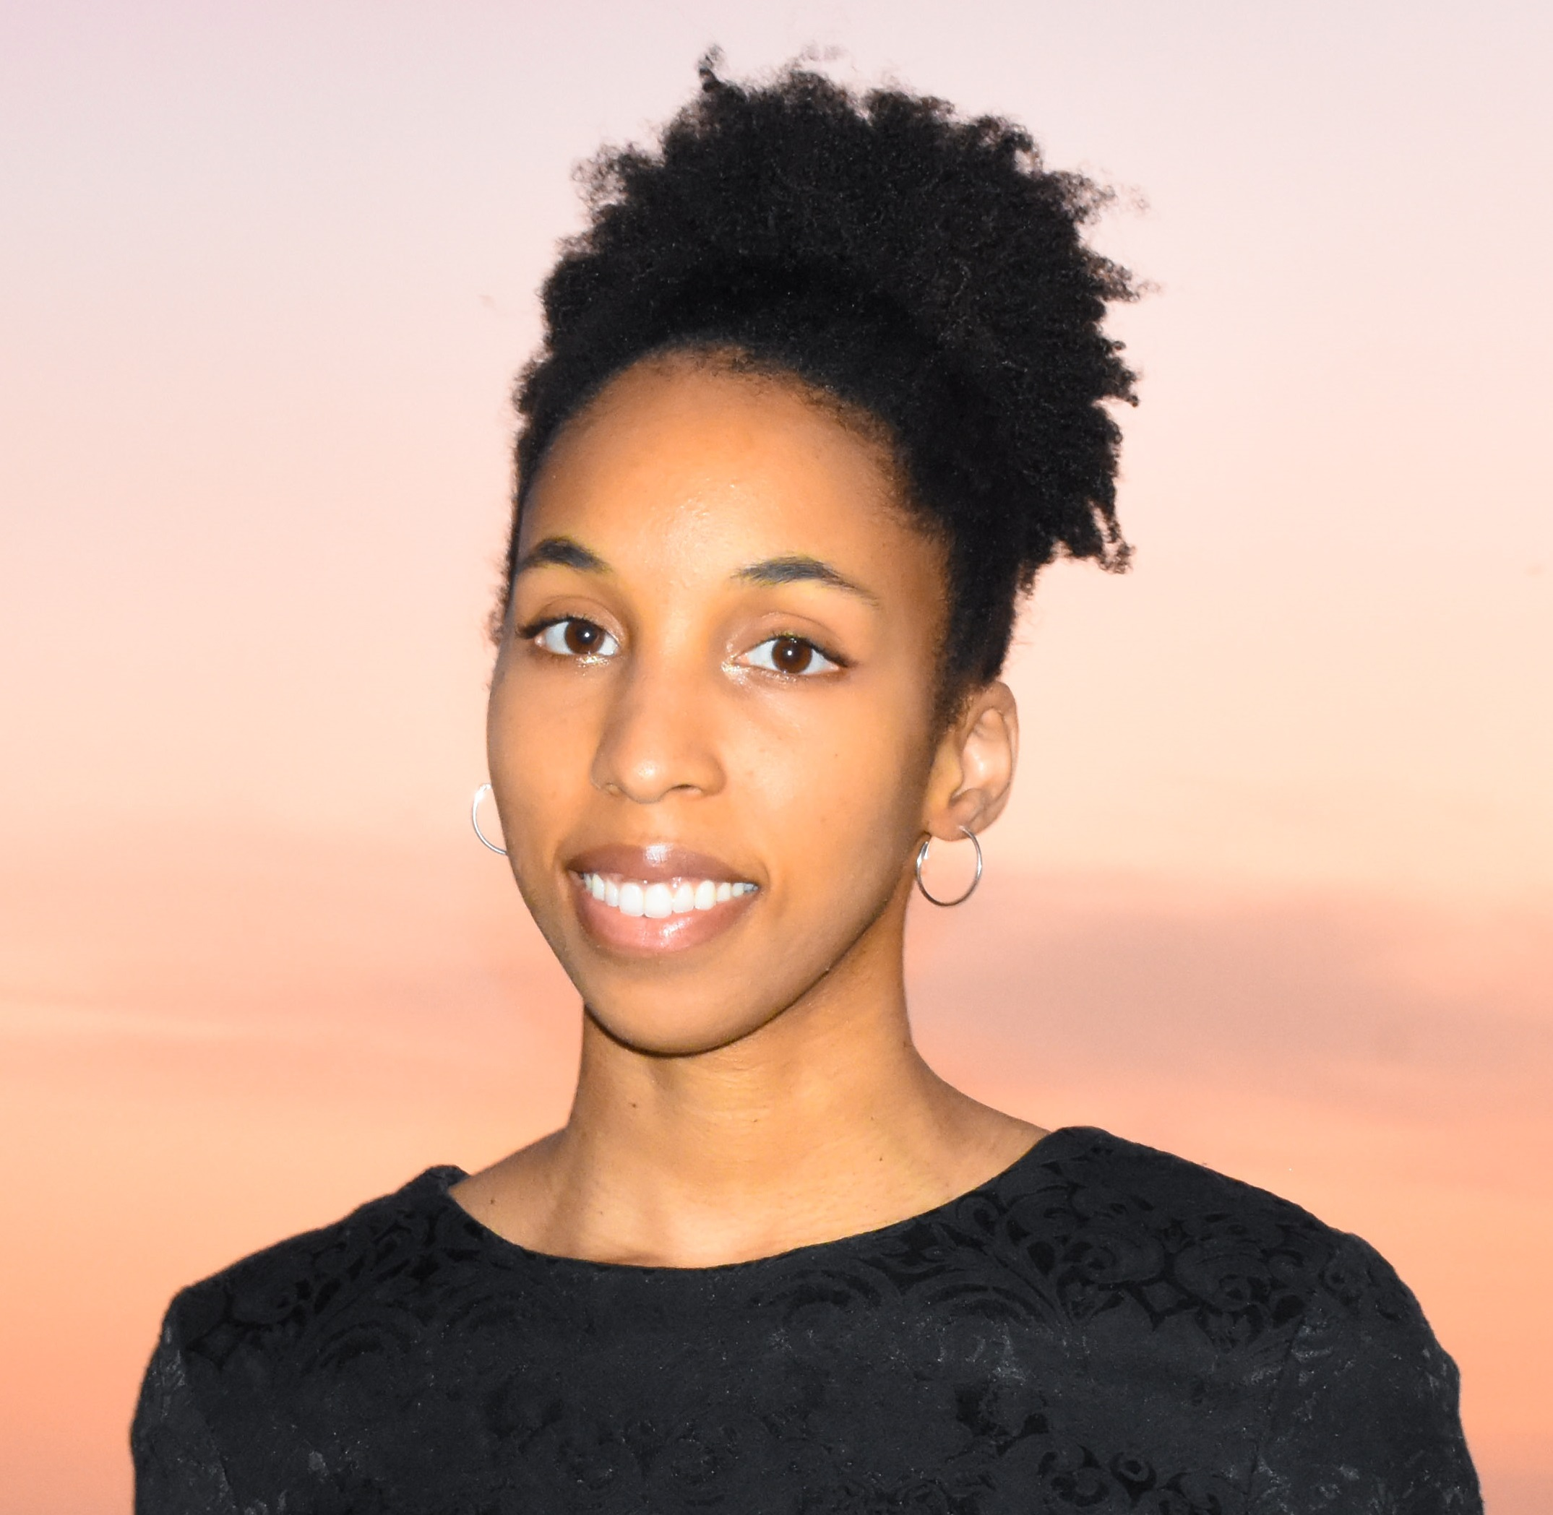
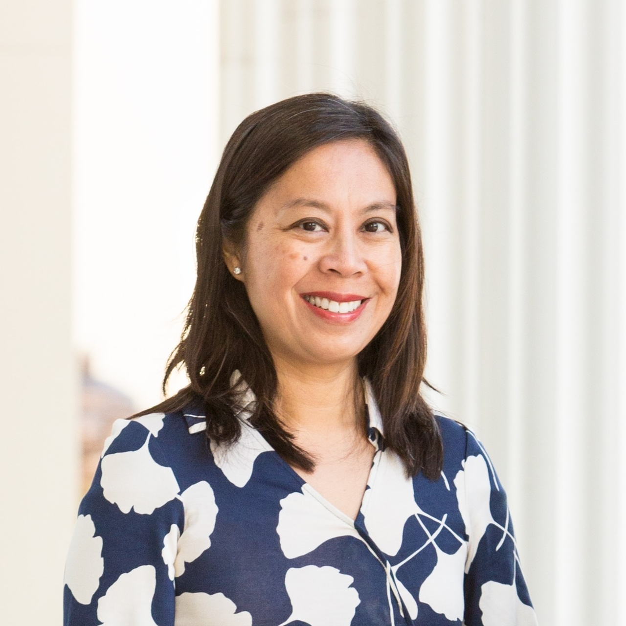
FAL Board
A Working Board
16 Members elected for 3-year terms, renewable
3 new Board Members added in 2023

Slide 5
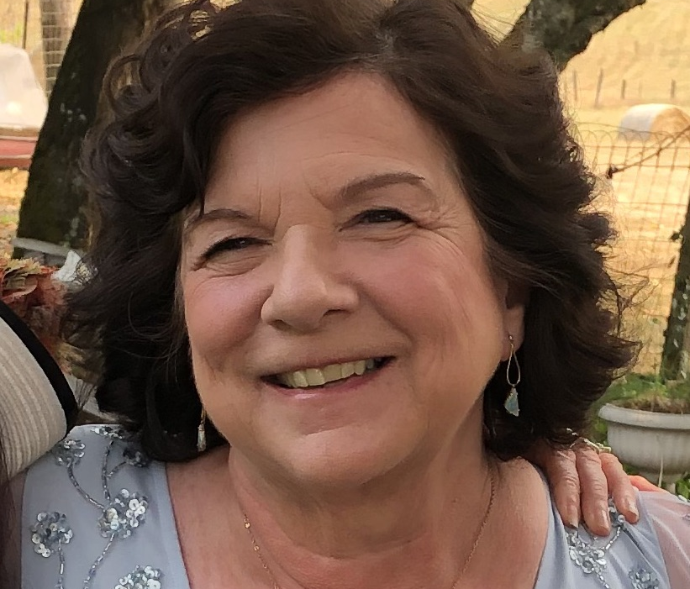
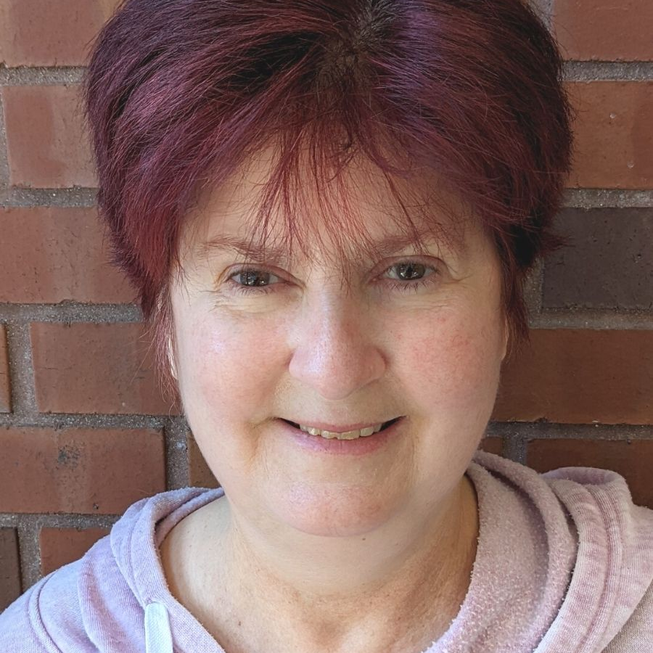
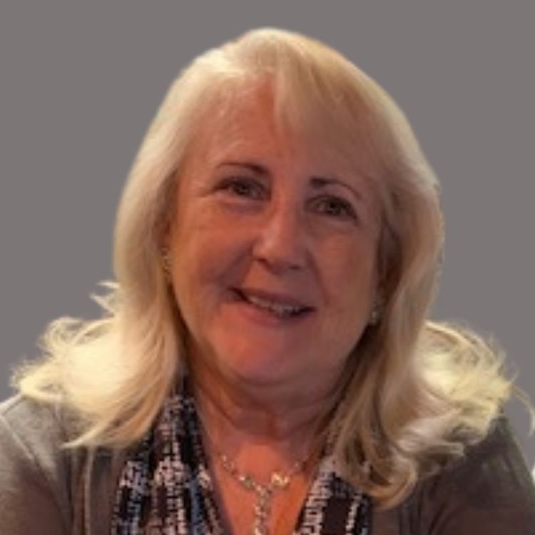
NEW BOARD MEMBERS IN 2022

Slide 6
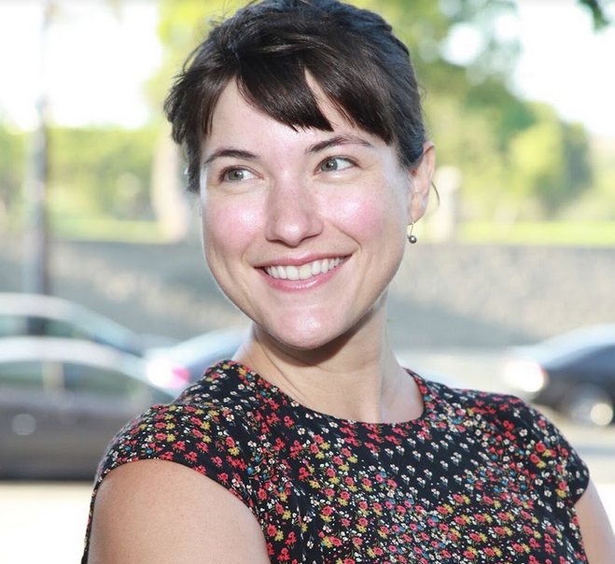
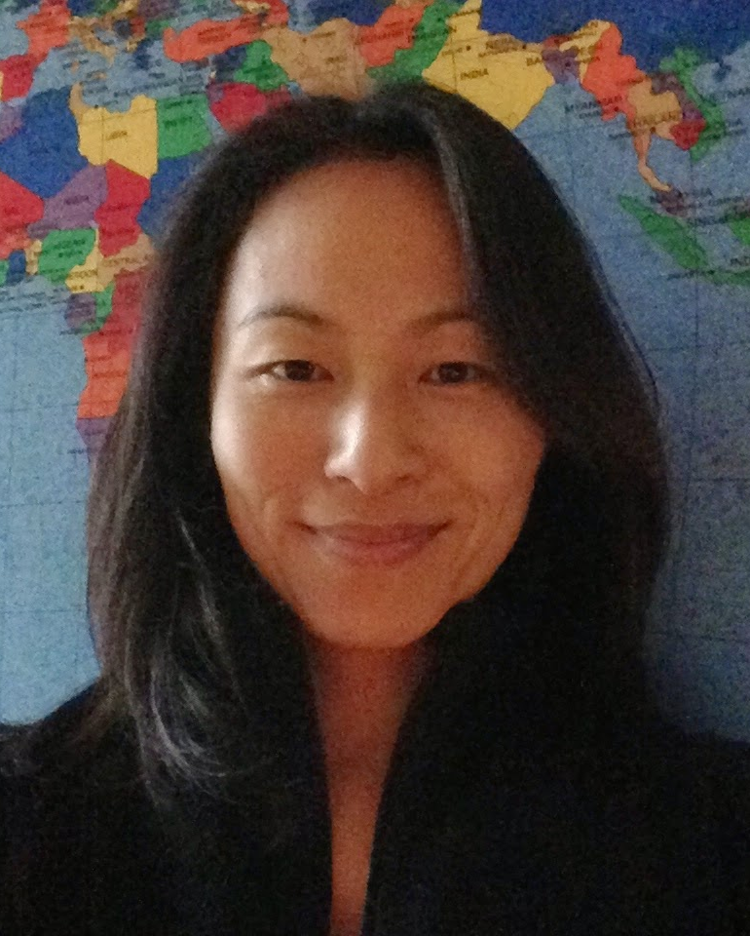
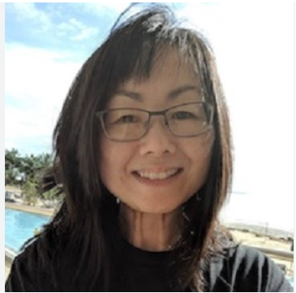
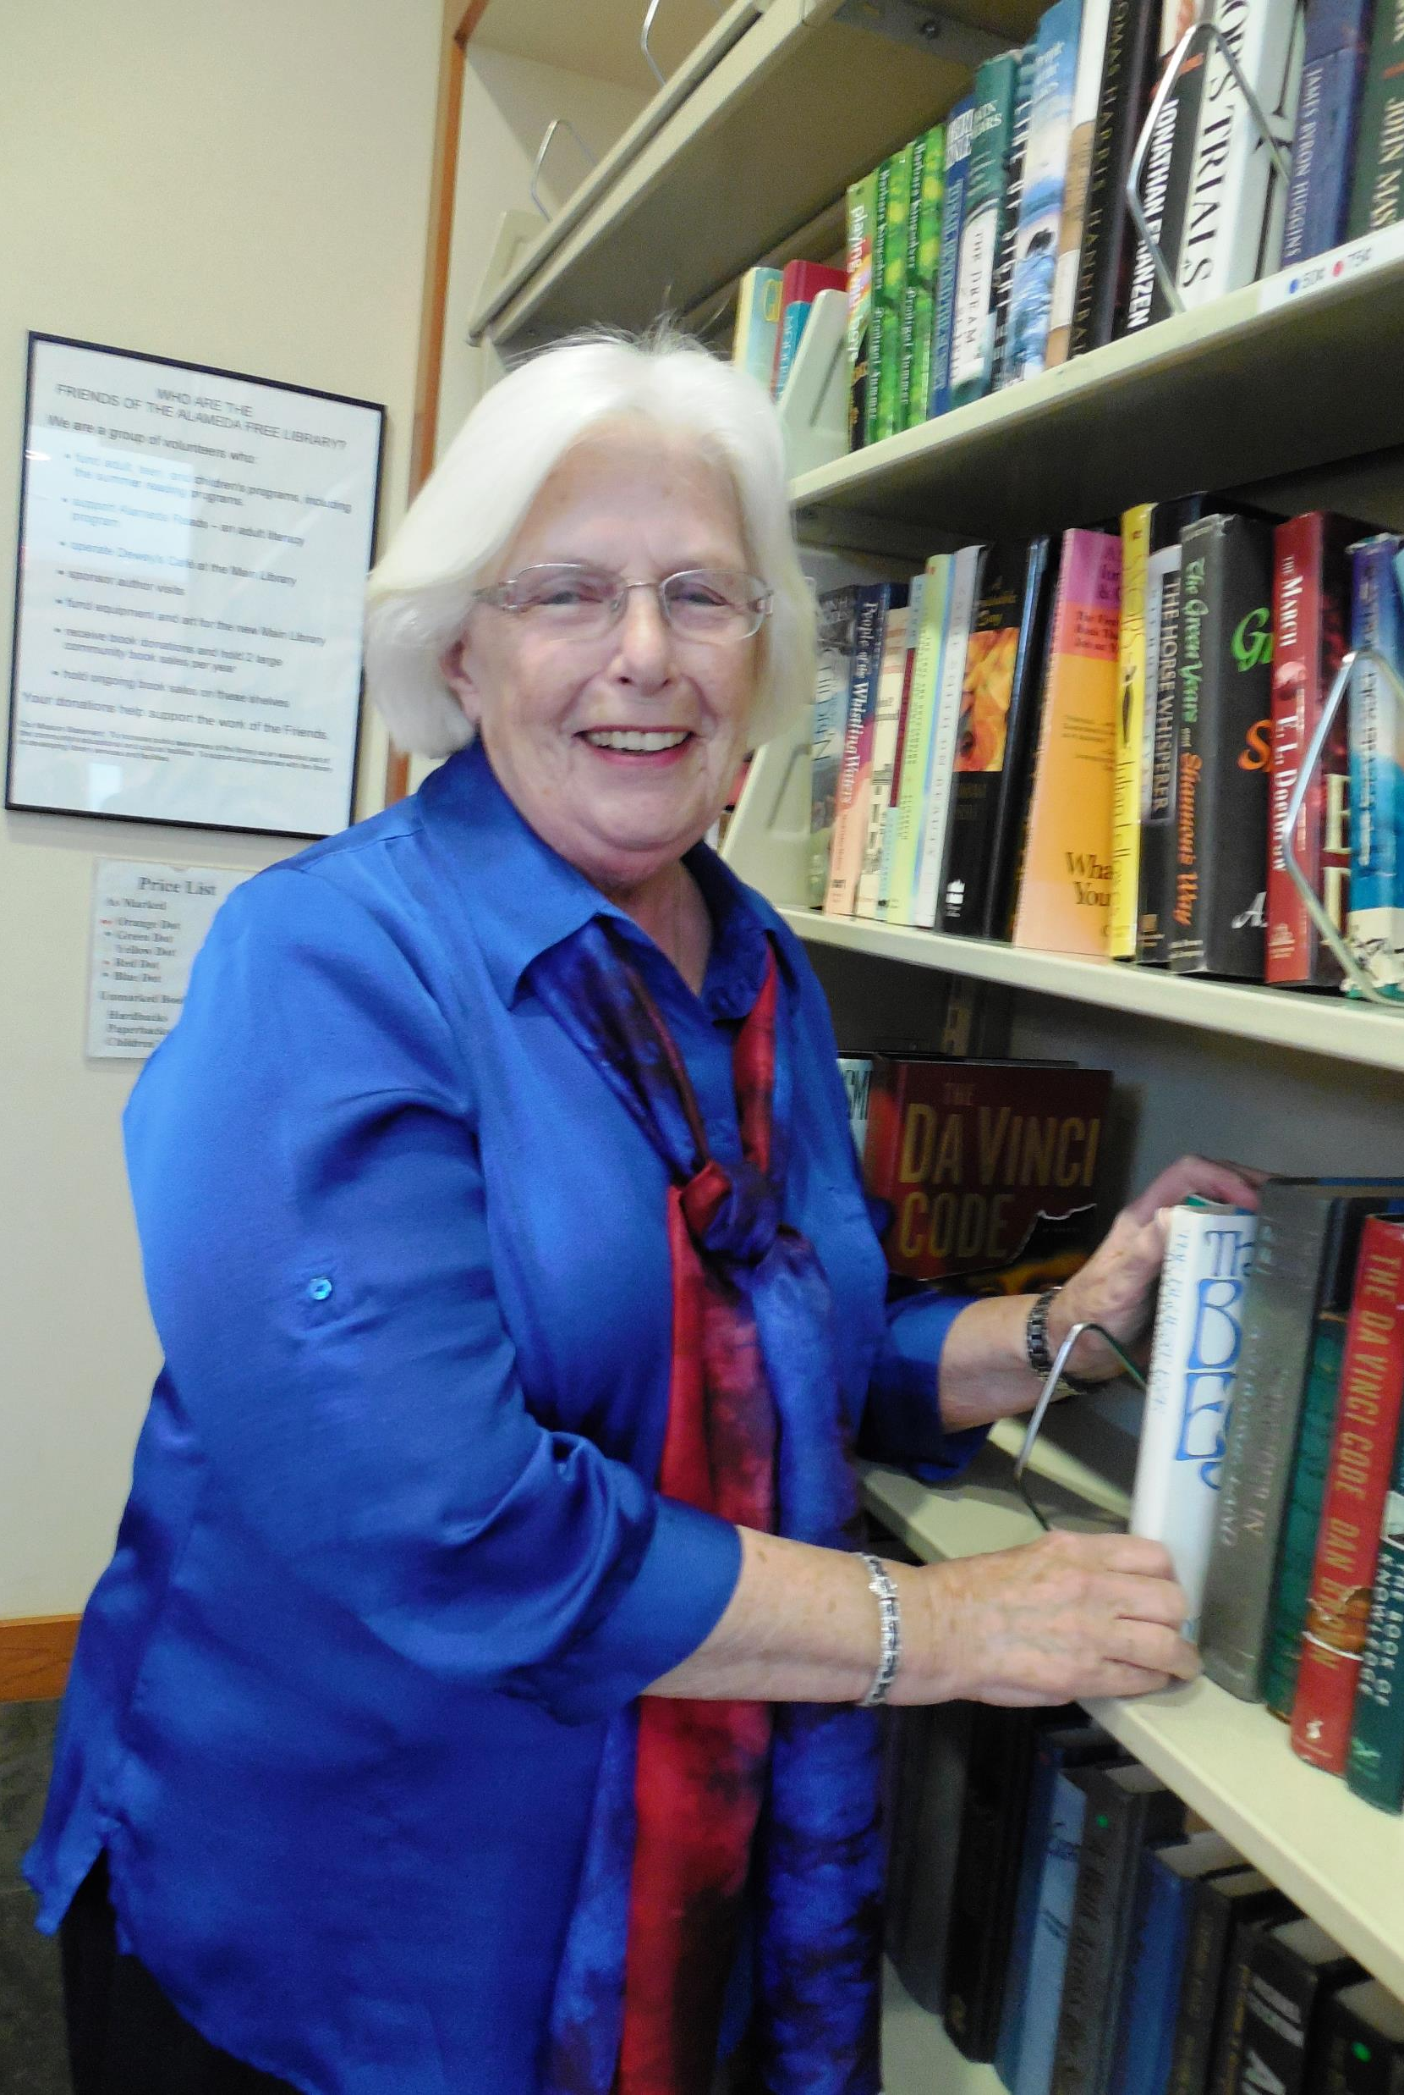
BOARD MEMBERS LEAVING IN 2022

Slide 7
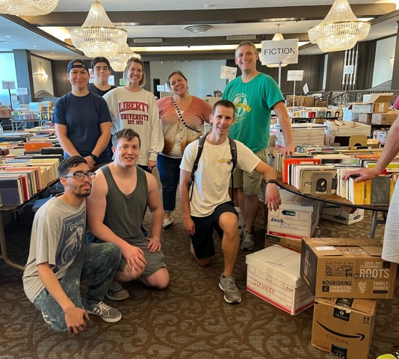
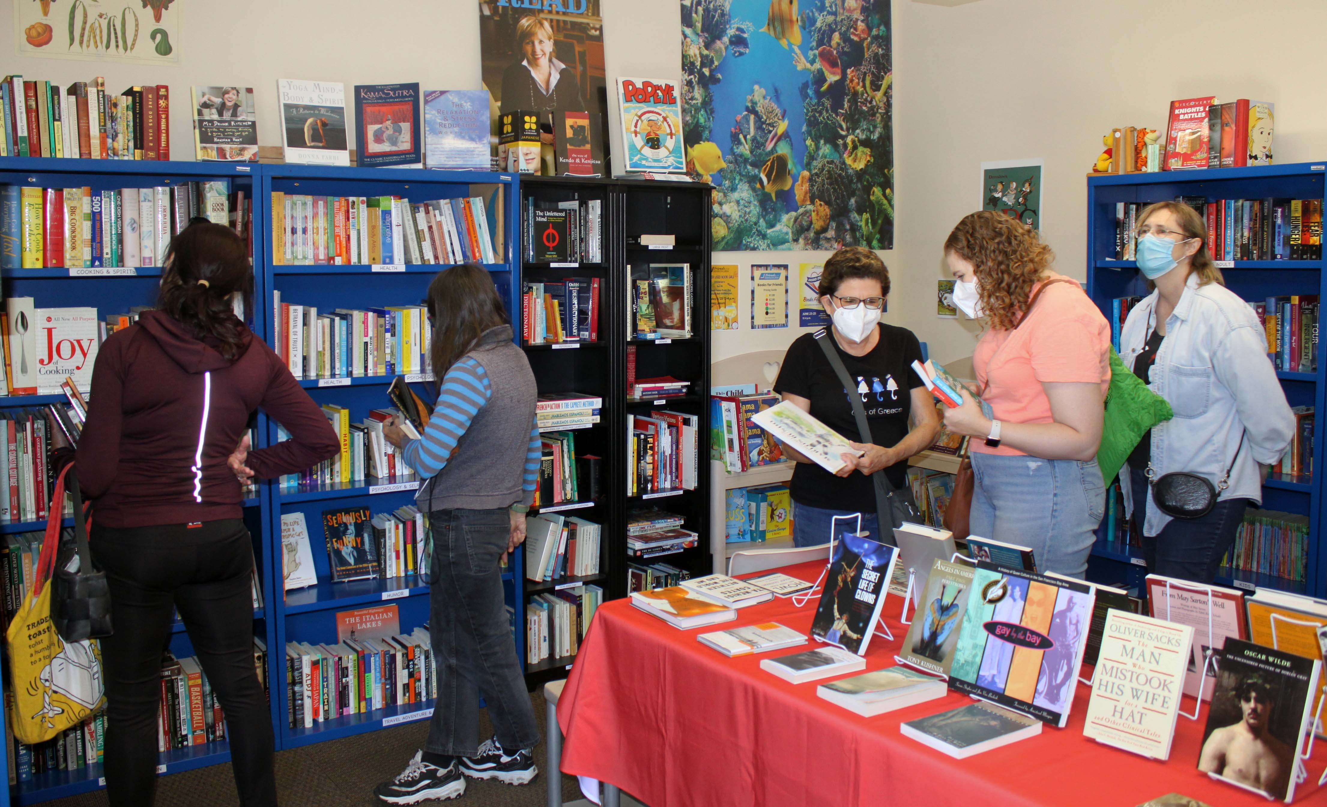
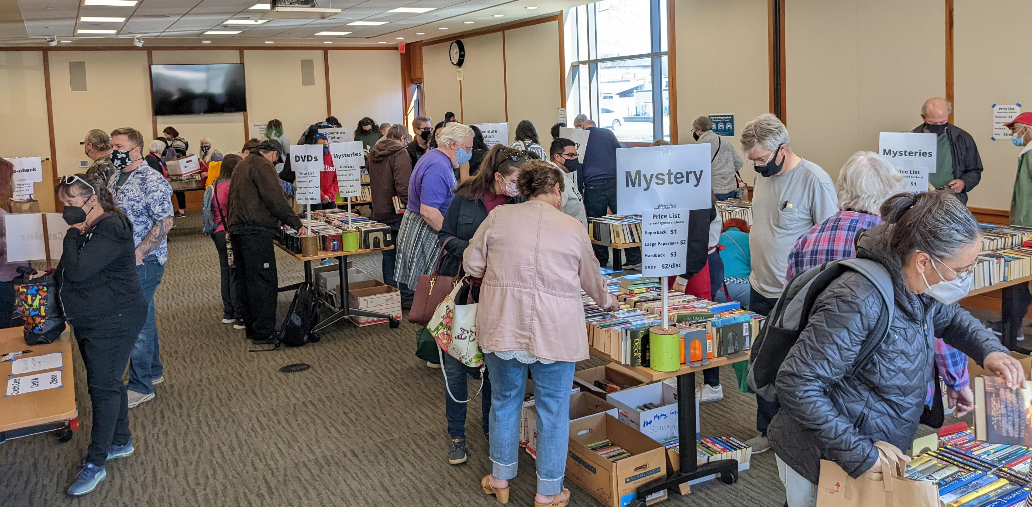
DIVERSIFICATION in USED BOOKSALES
BIG BOOK SALE
BOOKS FOR FRIENDS
MINI BOOK SALE

Slide 8
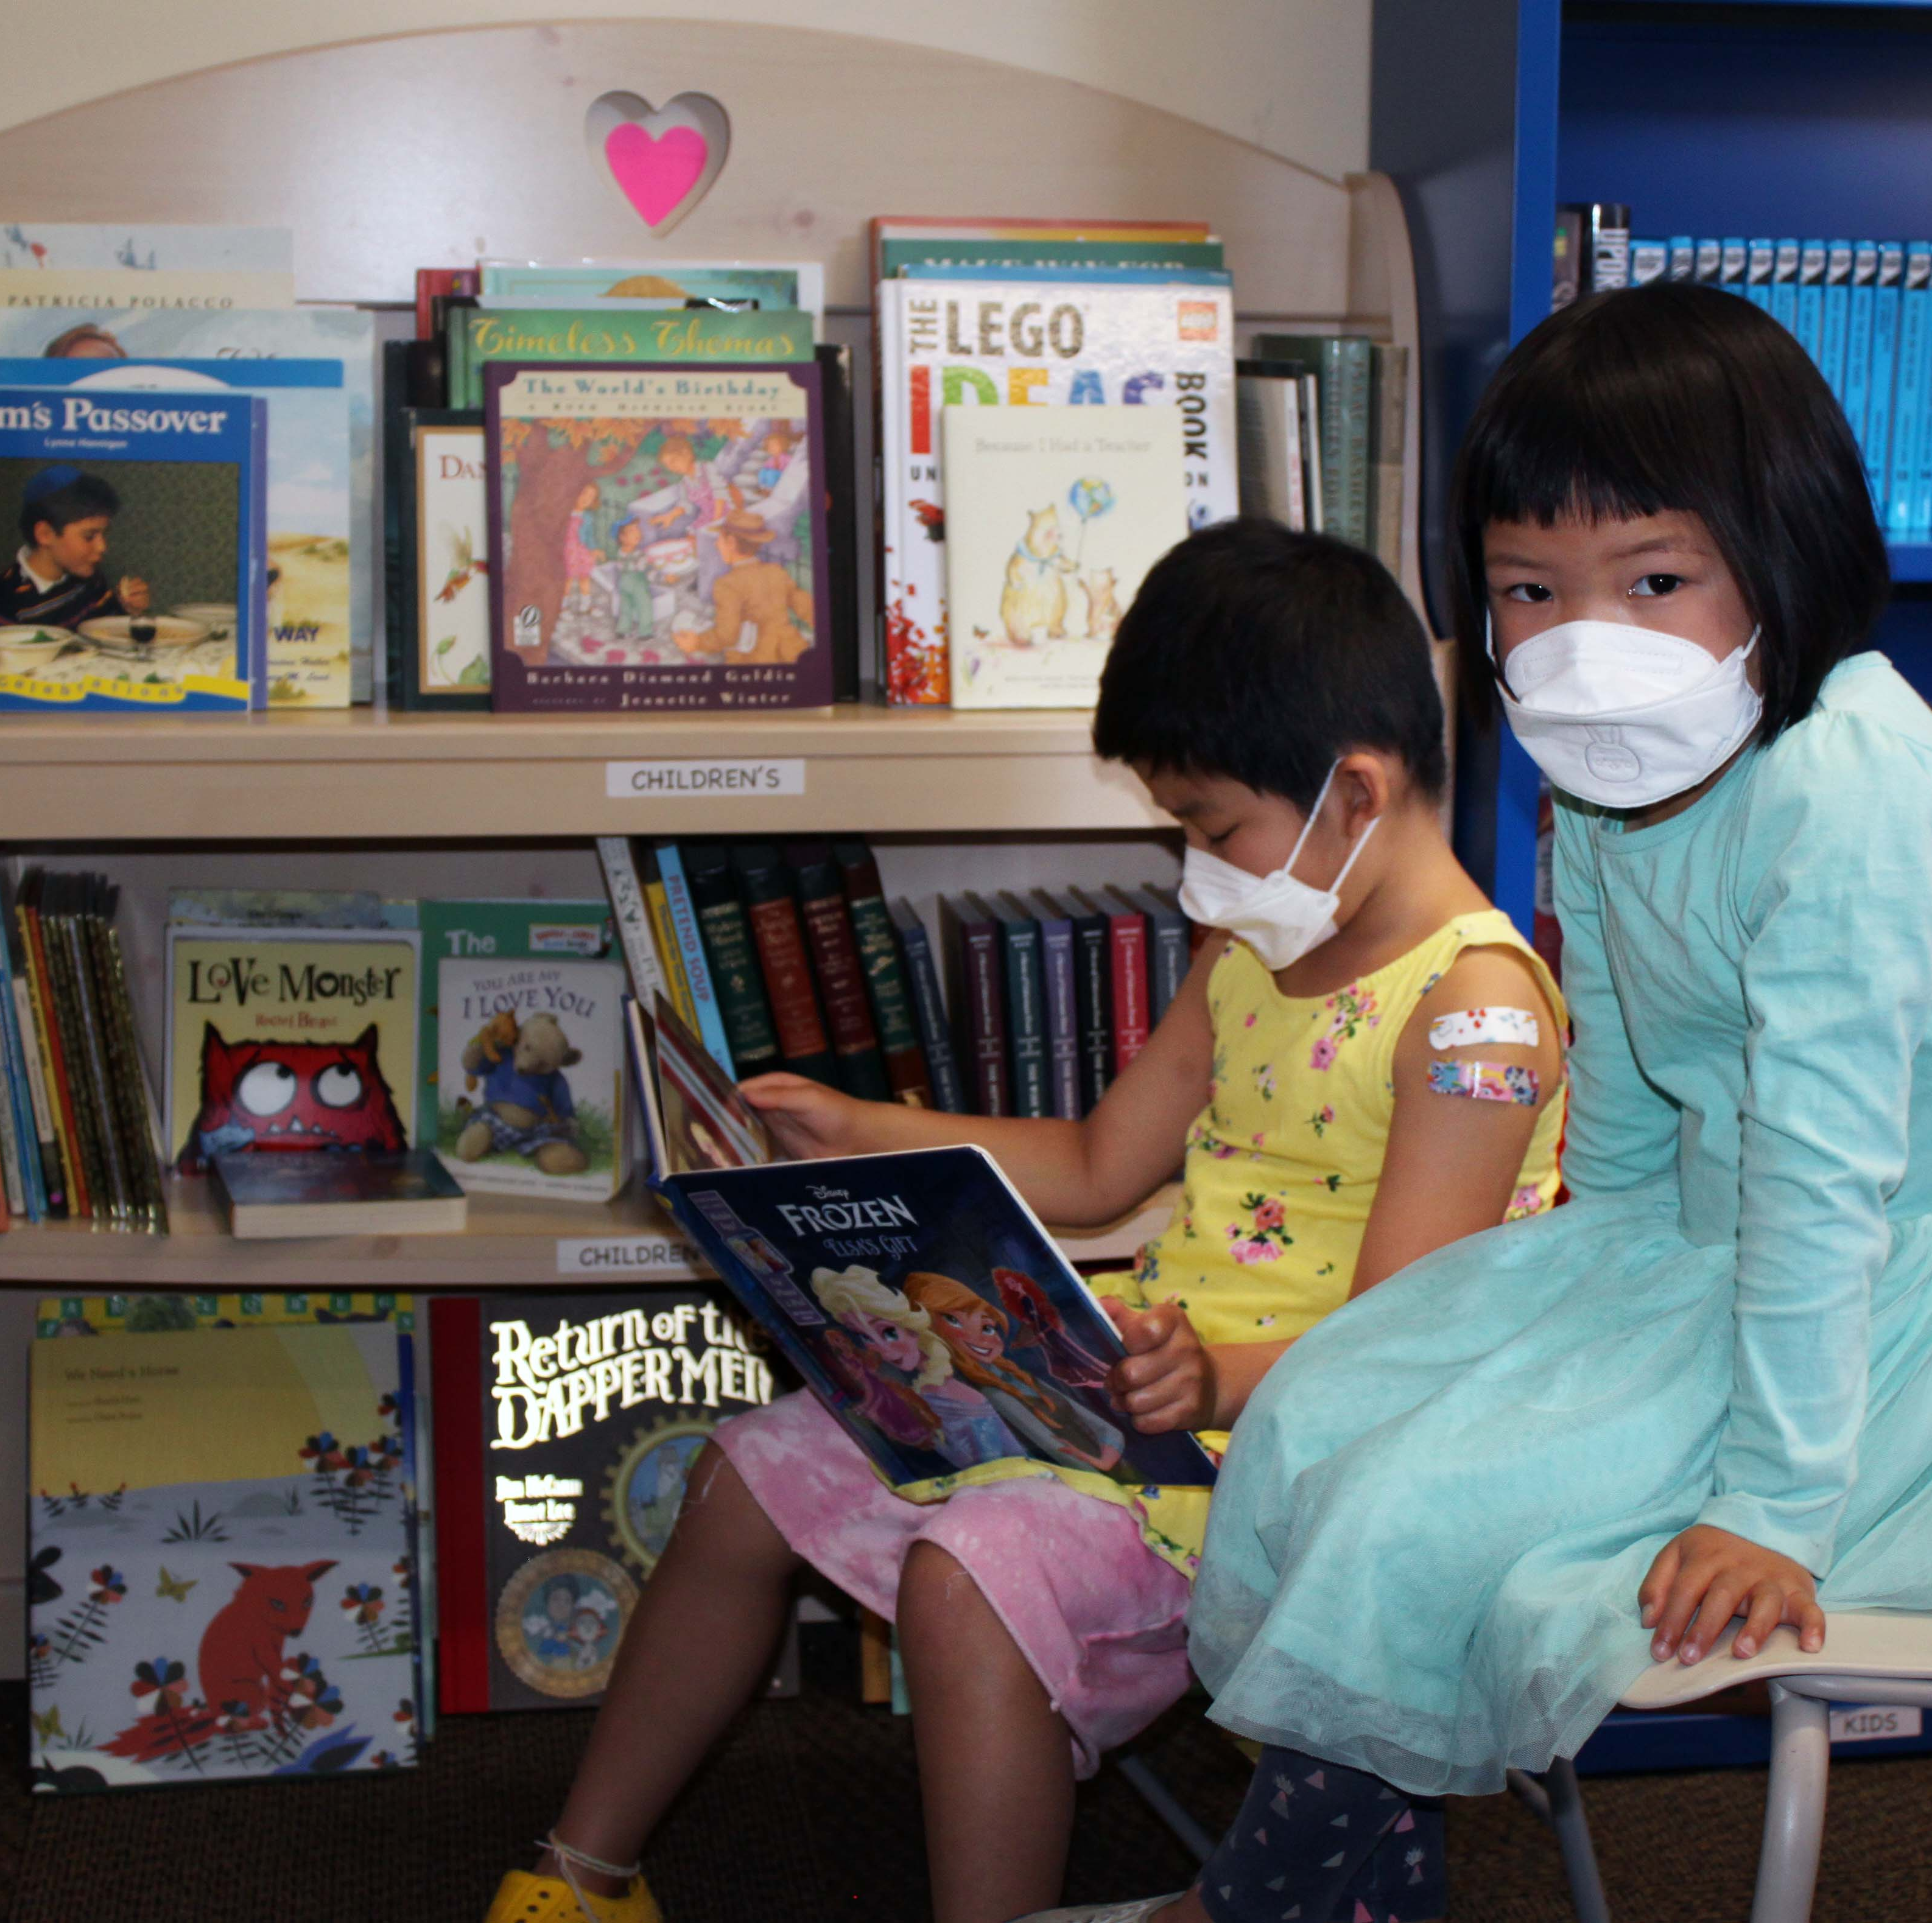
USED BOOKSALE PLANS FOR 2023
SCHEDULE THE O’CLUB BIG BOOK SALE IN FALL 2023
HOLD 2 MINI SALES AT THE LIBRARY’S STAFFORD ROOM
MARKET BFF TO INCREASE SALES
  CONTINUE TO WORK WITH BOOKFOREST AND AMAZON FOR HIGHER VALUE USED BOOKS

Slide 9
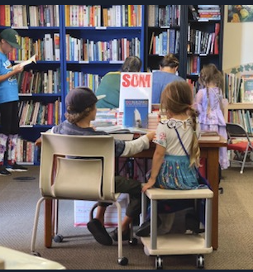

BOOKS FOR FRIENDS - BFF
OPENED March 2022

Slide 10

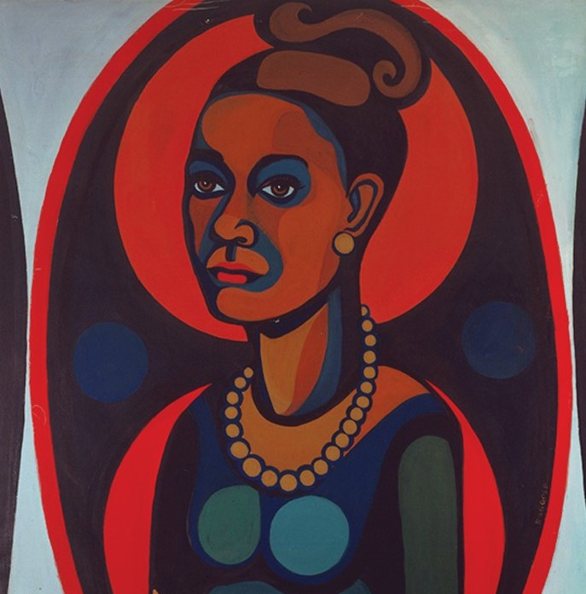
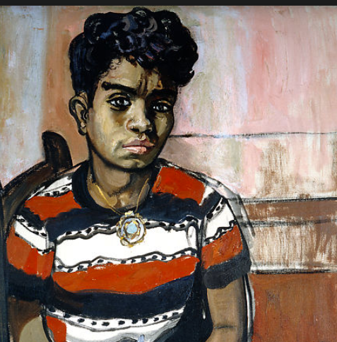
FRIENDS @ HOME 2022 ART DOCENT PRESENTATIONS
13 PRESENTATIONS – Alice Neel, Faith Ringgold, The Obama Portraits, Ramses the Great, Picasso and His Women, Visions of the Southwest: Ansel Adams and Georgia O’Keefe

Slide 11



FRIENDS @ HOME: 13 AUTHOR PRESENTATIONS

Slide 12
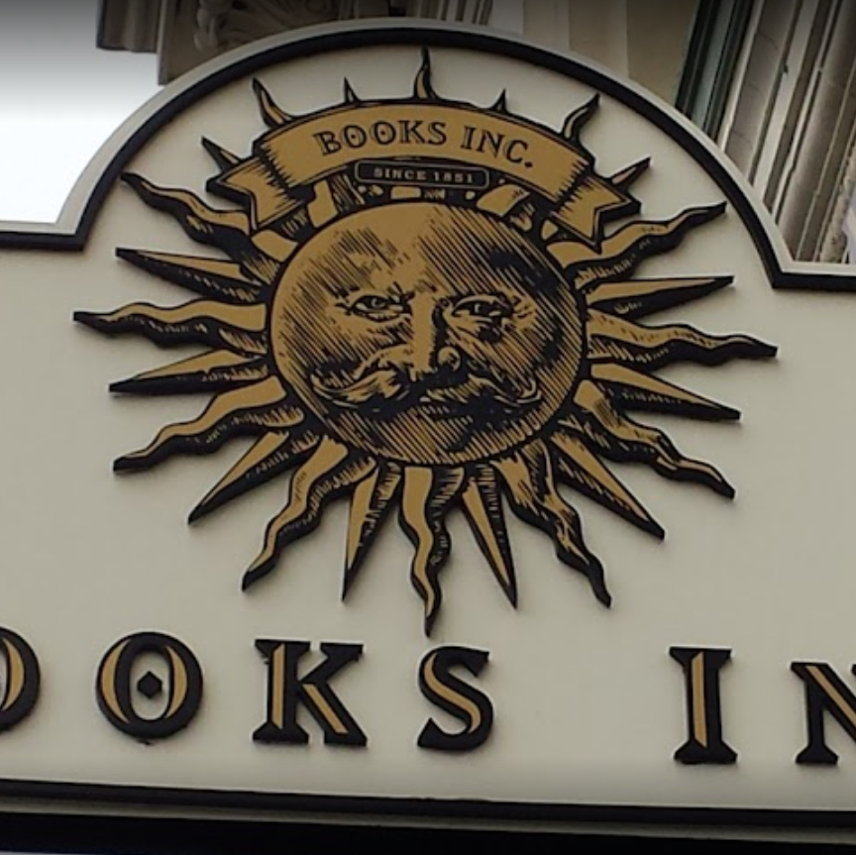
BOOKS INC FUNDRAISER
FUNDRAISING PARTNERSHIP
THE COMMUNITY PURCHASED BOOKS REQUESTED BY AUSD SCHOOL LIBRARIANS
OVER $1,000 RAISED FOR FAL
  DELIVERED 100-150 BOOKS TO ALAMEDA SCHOOLS

Slide 13
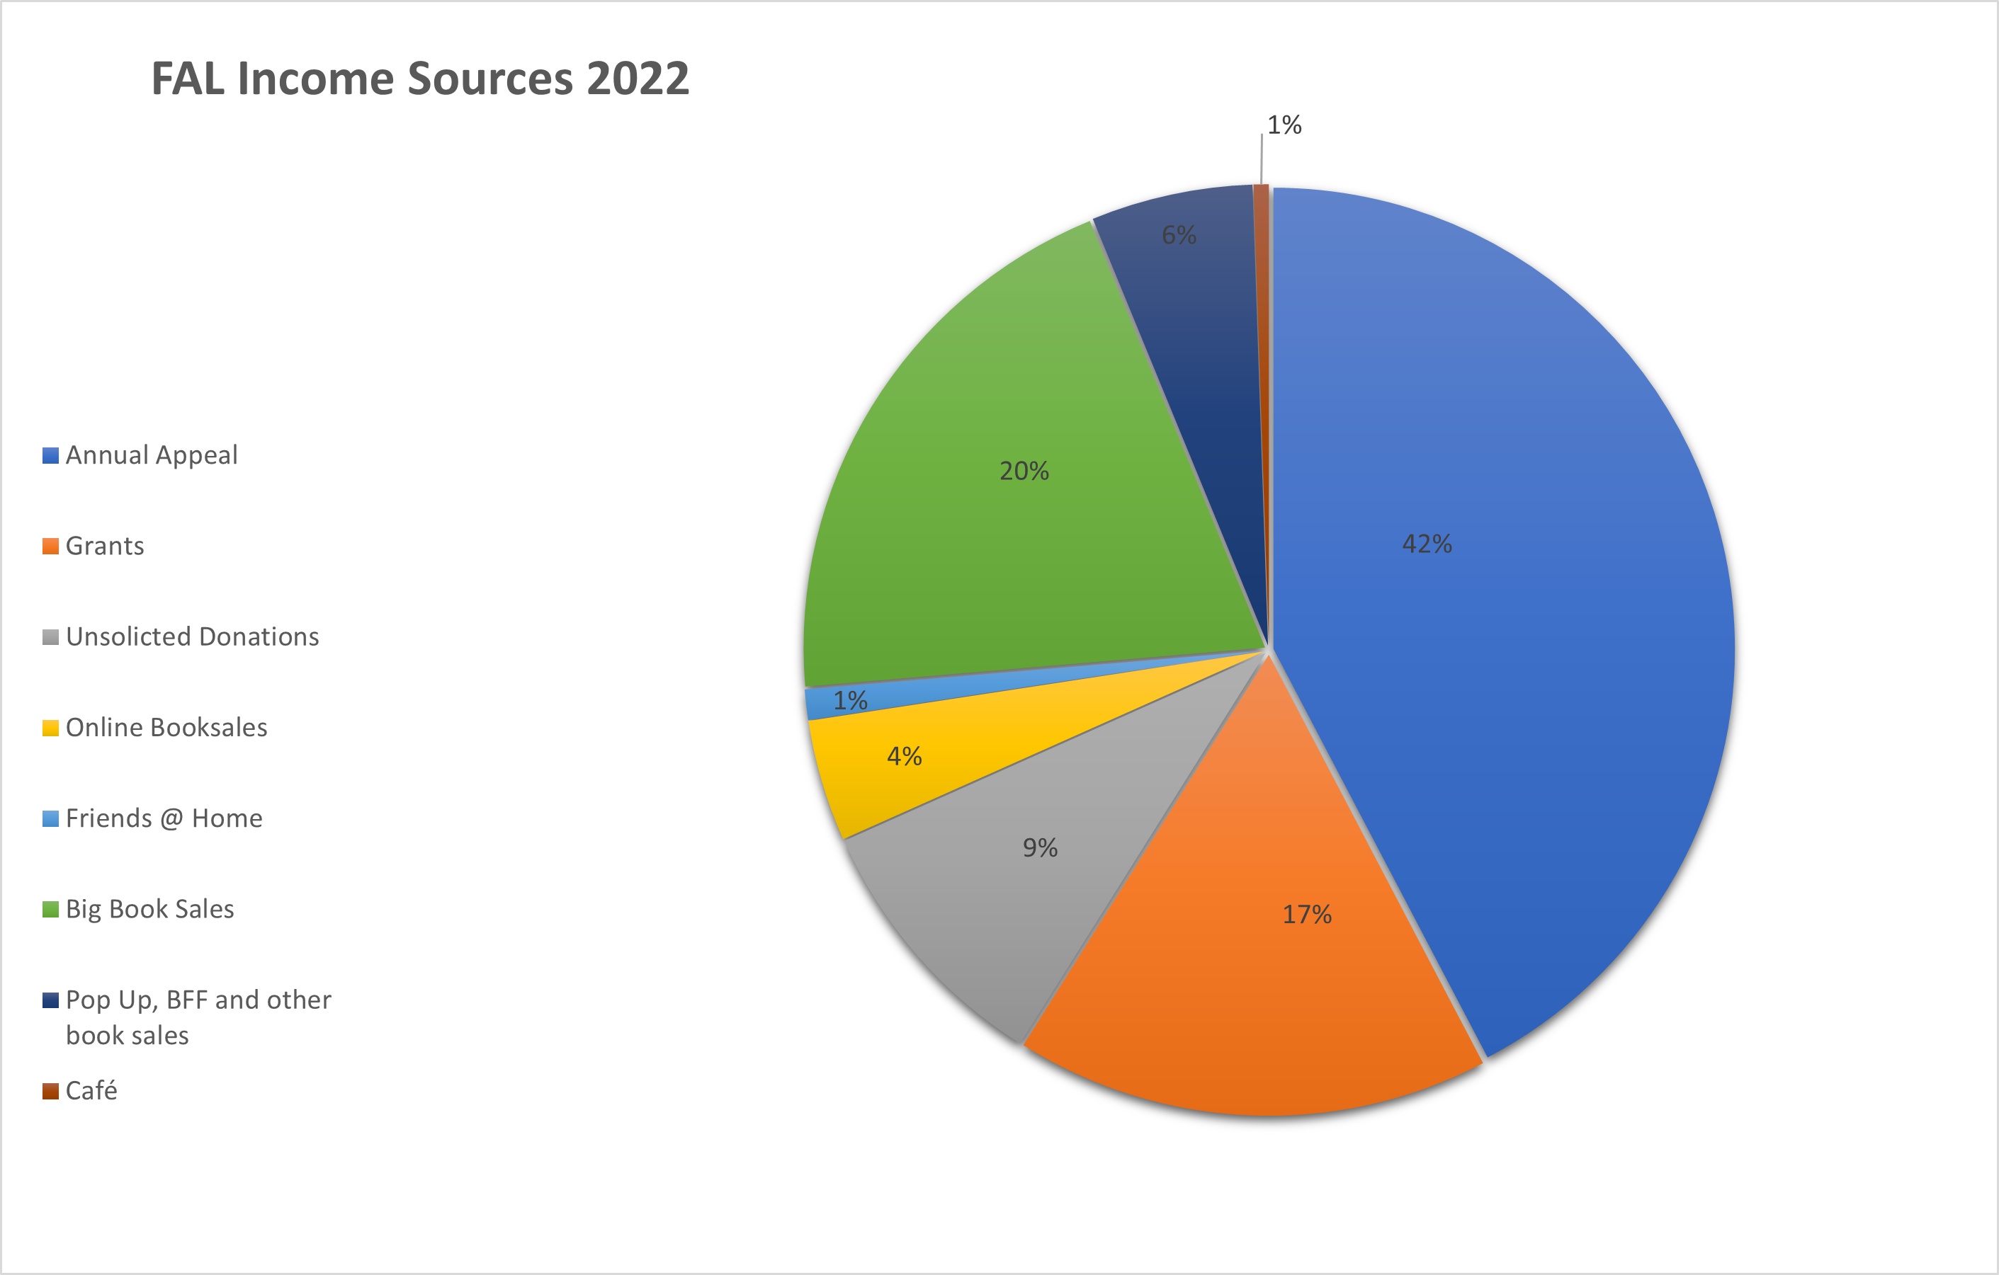
2022 FAL Income Sources
Mini Book Sales, BFF and other sales 6%
Café 1%
Big Book Sale 20%
Annual Appeal 42%
Friends @ Home 1%
Online Book Sales 4%
Unsolicited
Donations 9%
Grants 17%

Slide 14
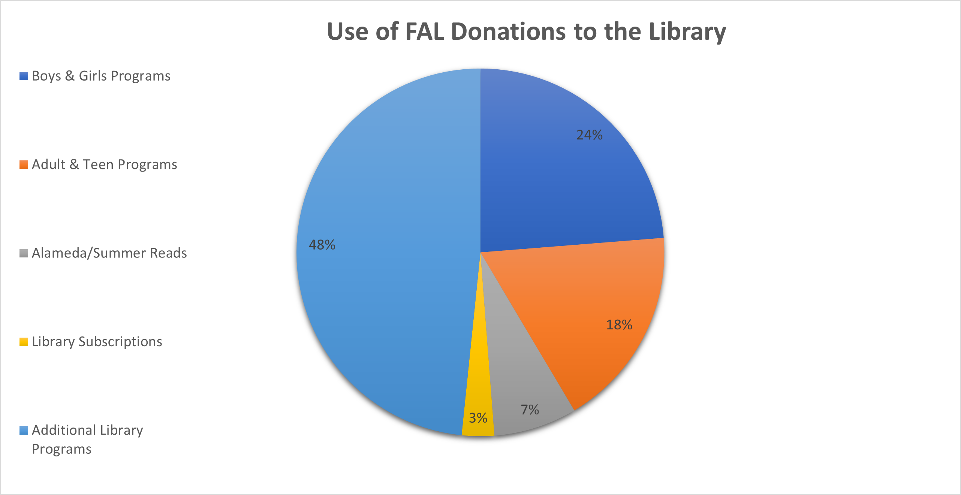
How the Library uses the Friends’ donations
Boys & Girls Programs 24%
Other Library Programs 48%
Adult & Teen Programs 18%
Alameda/Summer Reads 7%
Subscriptions 3%

Slide 15
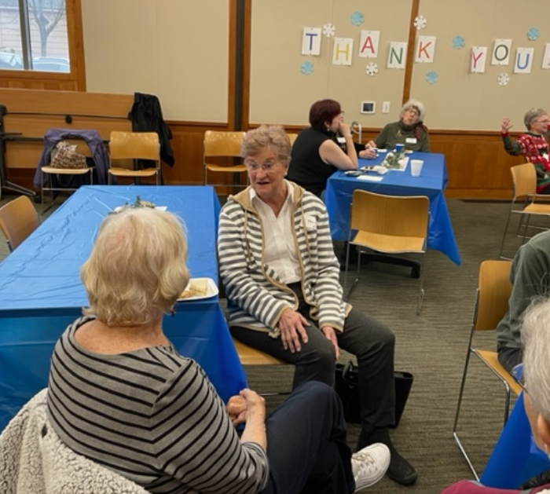
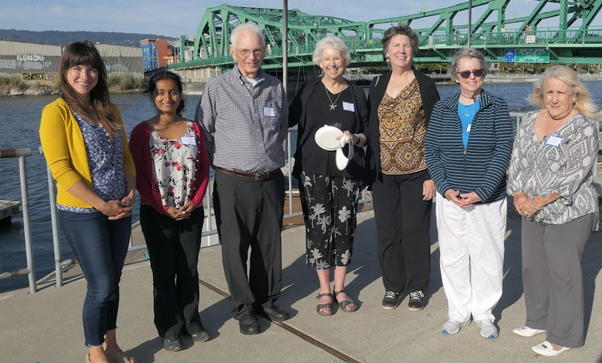
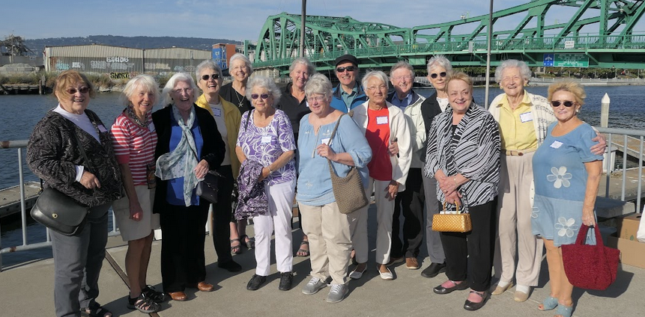
THANKS TO OUR VOLUNTEERS!

